Slide 1


SAP Full-Stack Developer
Training
ABAP on HANA, UI5 & Fiori, Analytics with OData
Anubhav Oberoy
Day – 5

Slide 2

Agenda – Day 5
Fragments
Working with Messages
---Break---
Fragments as Dialog
Extending standard Control
Application Extensibility

Slide 3
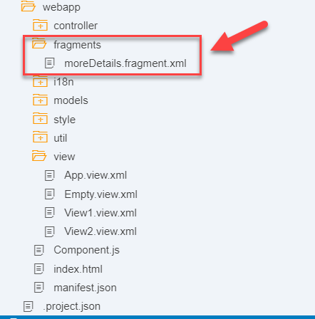
What is fragment ?
Fragments are light-weight UI parts. They are used to modularize views. We can reuse a fragment multiple times in same view or other views.
This class acts as factory which returns the UI control tree defined inside the Fragments.
Fragments are used similar as sap.ui.core.mvc.Views, but Fragments do not have their own controllers. Logic related to fragment’s UI elements is written in the host view’s controller.
Fragments are used similar as sap. ui.
Do not call the Fragment constructor directly!
Use-cases for Fragments are e.g.: - Modularization of UIs without fragmenting the controller structure - Re-use of UI parts - 100%- declarative definition of Views.
Constructor of Fragment is
new sap.ui.core.Fragment()

Slide 4
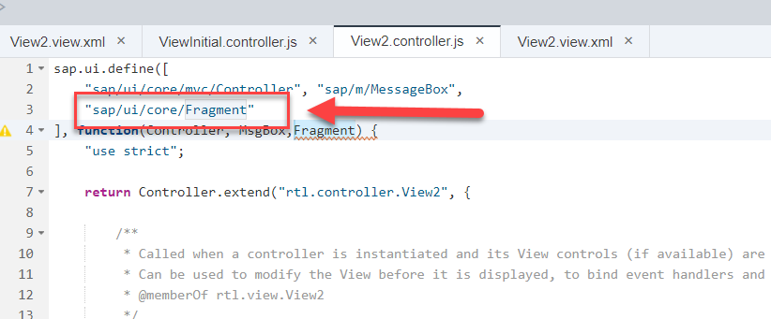
Fragment loading
Loads and instantiates a Fragment. A Promise is returned, which resolves with the Fragments content.
The Fragment types "XML", "JS" and "HTML" are available by default; additional Fragment types can be added using the sap.ui.core.Fragment.registerType() function.
Fragments can be instantiated from JSViews, as well. Fragments of any type can be used within views of any type.
Module name for fragment loading is “sap/ui/core/Fragment”

Slide 5
Types of Fragments in sapui5
JS fragments
XML fragments
Types
HTML fragments.
Trainer: Anubhav Oberoy

Slide 6
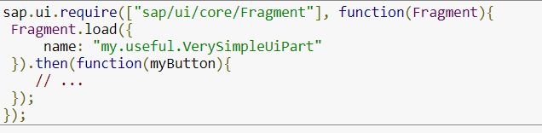
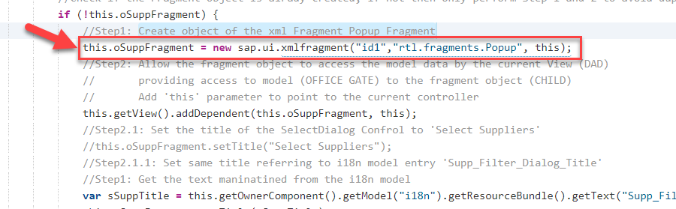
Loading a XML fragment (default type)
Create object of the xml Fragment Popup Fragment
Trainer: Anubhav Oberoy

Slide 7
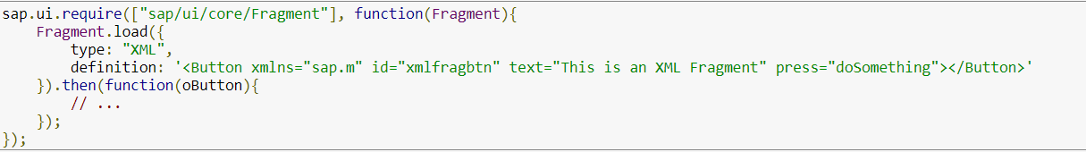
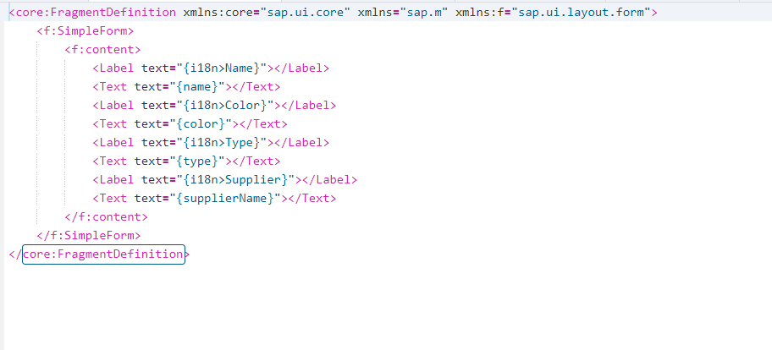
Create a XML fragment
Trainer: Anubhav Oberoy

Slide 8
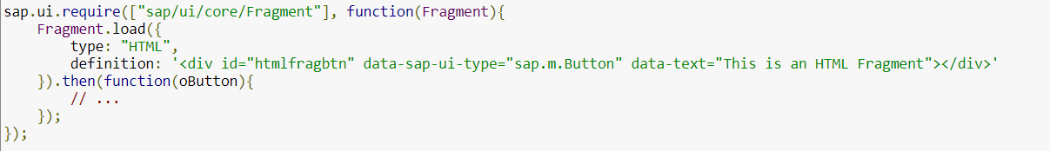
Creating an HTML fragments
Trainer: Anubhav Oberoy

Slide 9

Exercise
Create a XML fragment
1.1 Add Info fragment
1.2 Add supplier data fragment
2. Load a xml fragment in View2.view.xml
Trainer: Anubhav Oberoy

Slide 10
What is Message
Messages can be used to notify the user about specific states of the application and can help the user to correct their incorrect inputs.
SAPUI5 provides a central place for storing and managing info, warning, and error Messages.
Message Object Properties
Target: Describes the part of the application to which the message applies.
Message processor: The object that handles the message in the application and propagates the message to correct controls , binding, or other object.
Types: Defines the severity of the message; possible types are error, warning, info, success.
Message Text: The actual message text describing the issue.
Persistent: This property influences the lifecycle of the message.
Trainer: Anubhav Oberoy

Slide 11
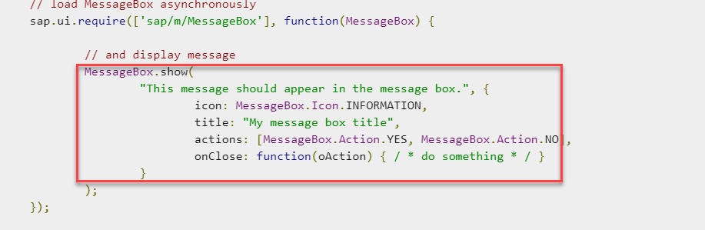
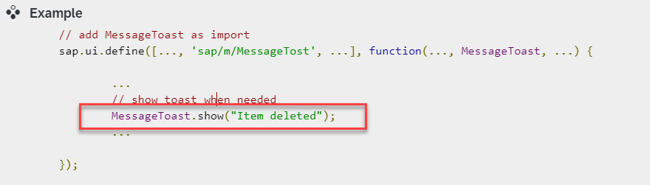
Message Dialog
A message dialog interrupts the user's workflow by blocking the current page and needs to be closed by the user.
Use a message dialog if the message is important and must be acknowledged by the user.
The easiest way of showing message dialog is to use the sap.m.MessageBox.
Trainer: Anubhav Oberoy

Slide 12
Types of Message Dialog
01
MessageBox
02
MessageItem
Message Dialog
03
MessagePage
04
MessagePopover
05
MessageStrip
06
MessageToast
07
MessageView
Trainer: Anubhav Oberoy

Slide 13

Break
Trainer: Anubhav Oberoy

Slide 14
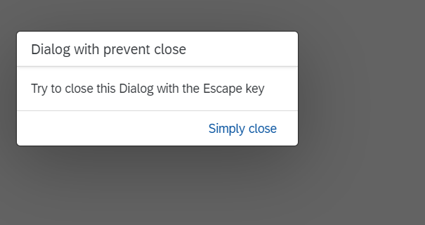
Fragment as Dialog
The Dialog control is used to prompt the user for an action or a confirmation.
It interrupts the current app processing as it is the only focused UI element and the main screen is dimmed/blocked.
The content of the Dialog is fully customizable.
API Reference: https://sapui5.hana.ondemand.com/sdk/#/api/sap.m.Dialog%23overview
Structure of Dialog:
A Dialog consists of a title, optional subtitle, content area and a footer for action buttons.
The Dialog is usually displayed at the center of the screen.
Its size and position can be changed by the user. To enable this, You need to set the properties resizable and draggable accordingly.
Trainer: Anubhav Oberoy

Slide 15
Types of Dialog fragment
Busy Dialog
Personalization Dialog
used to block the screen and inform the user about an ongoing operation
6
1
used for personalizing sorting, filtering and grouping in tables
View Setting Dialog
Select Dialog
used to sort, filter, or group data within a (master) list or a table
5
2
used to select one or more items from a comprehensive list
Dialog Types
Value Help Dialog
4
3
Table Select Dialog
used to help the user find and select single and multiple values
used to select one or more items from a comprehensive list
Trainer: Anubhav Oberoy

Slide 16
Responsive behavior of Dialog
Uses:
To display a system message.
To interrupt the user’s action.
To show a message with a short and a long description.
Behavior:
If the stretch property is set to true, the Dialog displays on full screen
If the contentWIdth and/or contentHeight properties are set, the Dialog will try to fill those sizes.
If there is no specific sizing, the Dialog will try to adjust its size t its content.
Smartphones
If the Dialog has one or two actions, they will cover the entire footer. If there are more actions, they will overflow.
Tablets
The action buttons in the toolbar are right-aligned. Use cozy mode on tablet devices.
Desktop
The action buttons in the toolbar are right-aligned. Use compact mode on desktop.
Trainer: Anubhav Oberoy

Slide 17

Exercise
Add a Dialog box
Add a Select Dialog fragment
1.1 add a filter in supplier data
2. Add a filter button in Supplier fragment
3. Add a filter functionality in view2 controller
Trainer: Anubhav Oberoy

Slide 18
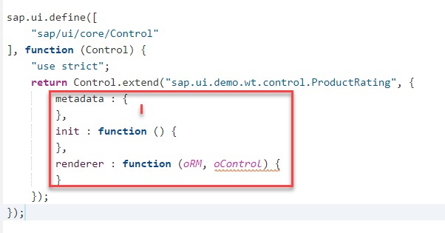
Custom control
A custom control is a JavaScript object that has two special sections ( metadata and renderer ) and a number of methods that implement the functionality of the control.
The metadata section defines the data structure and thus the API of the control.
The init method is a special function that is called by the SAPUI5 core whenever the control is instantiated.
SAPUI5 allows string, int, float, Boolean, object and arrays of the mentioned types as predefined data types.
In case if there is functionality which us not delivered by SAP, We can design our own control.
sap.ui.core.Control is the super class of all UI Controls
Extends is the keywords used to indicate inheritance in JS.
Trainer: Anubhav Oberoy

Slide 19
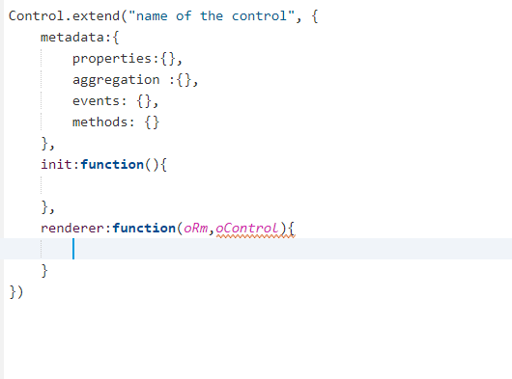
Syntax of Custom Control
oRm is the renderer object to talk to the browser and tell the browser to put something in DOM
Object of the current control which we are designing, with the help of this object oContol, we can access properties
Trainer: Anubhav Oberoy

Slide 20
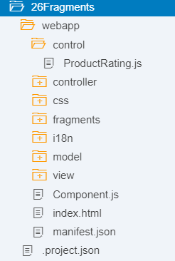
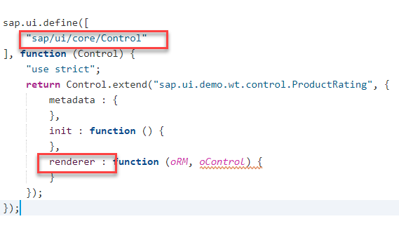
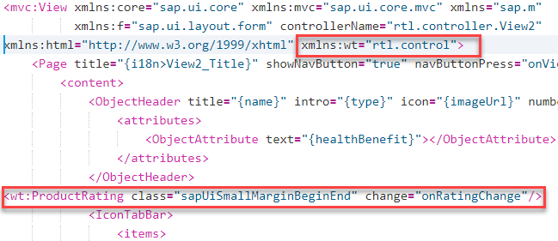
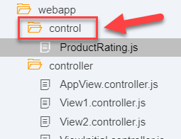
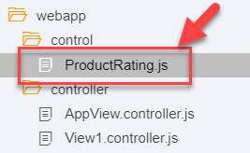
Steps of create custom control in ui5
01
02
03
04
05
.
Create a sample SAPUI5 project in WebIDE
Create a folder in webapp – control
Use the custom control and define function in controller & view
Create a js file in control
Provide a control name
Trainer: Anubhav Oberoy

Slide 21

Exercise
Add a rating indicator for customer
Add a new folder and make a js file in this folder
Add a functionality in view2 xml
Add a functionality in view2 Controller
Update i18n file
Update the version in manifest file
Trainer: Anubhav Oberoy

Slide 22

End of Day 5

Slide 23

Questions

Slide 24

Anubhav Oberoy

Slide 25


We’re committed to empower you to be
Most Desirable Resource
through powerful training solutions.
We build the workforce of the future.
250+
Corporate Clients
30,000+
Learners Trained
25000+
Learners Placed
FREE WEBINARS
Sign up for free webinars with industry experts every fortnight!
Enroll Now!
Contact us today!
https://anubhavtrainings.com/

Slide 26




More from AnubhavTrainings.com

